Slide 1

Presentation for the Front-end Part
3 mins per group

Slide 2

1. Member
** project leader
(who will upload this presentation to the Moodle )
1.20232085 AnJiaqi Dr.Trump
2. Name ID Sec. <<fill in your information>>
3. Name ID Sec. <<fill in your information>>
<<insert your photo>>
<<insert your photo>>
<<insert your photo>>
<<Name>>
<<Name>>
<<Name>>
** project leader

Slide 3
2. Project name/Project Goal
Project name: Truth Portecter
Project goal: Share news, discern truth from falsehood, freedom of speech, open communication.
Identifying fake news in sports, music, games, weather, economy, anime, and drama

Slide 4
3. Features
F1 A mechanism for verifying authenticity with public participation. The system uses a crowdsourcing model, allowing every user to participate in assessing the authenticity of news, thereby avoiding biases from a single institution or individual.
F2 Comprehensive news lifecycle management. It supports the full process of news from submission, display, voting, to status determination, with statuses automatically updated based on voting results.
F3 Rich interactions and personalized experiences. Provides features such as news filtering, pagination control, and search, while also recording users' voting history to prevent duplicate votes. The interaction is smooth and aligns with user habits.
F4 Responsive design and modern UI. A responsive interface built with Tailwind CSS features card layouts, hover animations, and state indicators, providing a clear visual hierarchy while being aesthetically pleasing and easy to use.

Slide 5
4. Tech Stack
1.Frontend fundamental technologies: HTML5 (semantic tags), CSS3, JavaScript (ES6+)
2.Style framework: Tailwind CSS v3 (used for quickly building responsive interfaces and custom styles)
3.Icon library: Font Awesome (provides icon support for scenarios such as news, polls, and navigation)
4.Data storage: localStorage (stores news data, poll records, and comments locally)
5.Layout technologies: Flexbox, Grid (achieve responsive multi-column layouts and flexible component arrangement

Slide 6
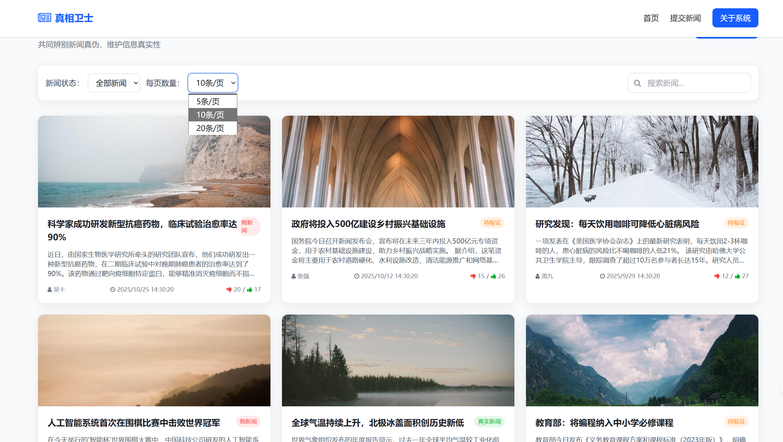
5. Home page
- list of news, filter (all / fake / not fake), pagination, and how many items per page?

Slide 7
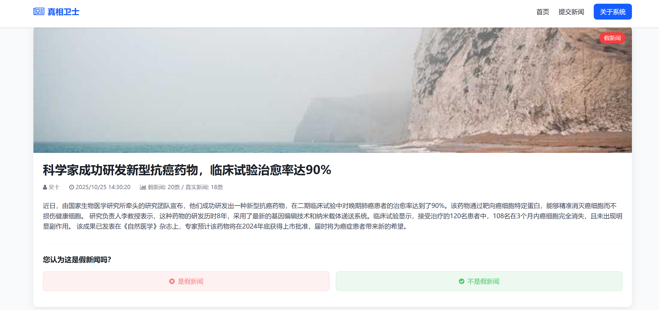
6. News Details Page
- Click on one news item to show: topic, full details, reporter, date/time, image (URL) - Show comment section and voting results (fake / not fake)

Slide 8
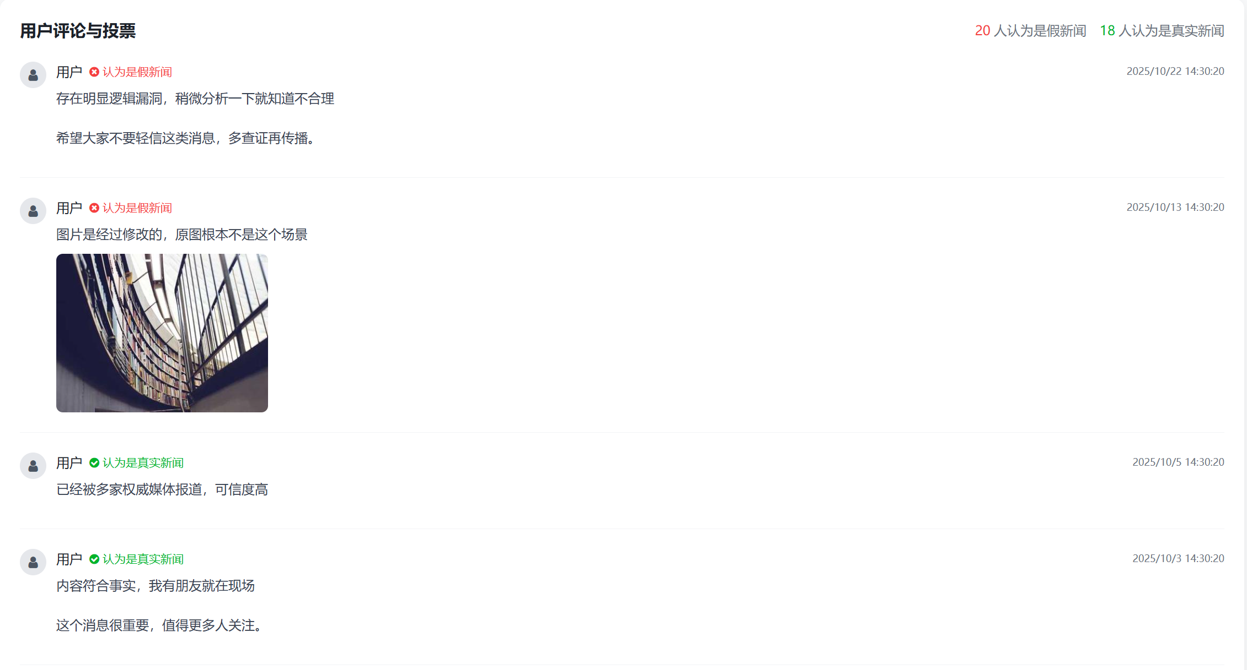
7. Vote & Comment Feature
- Demonstrate voting and adding a comment or image link - Show that new data appears in the comment list immediately

Slide 9
8. Deployment with Versel
Vercel deployment support. Project code can be directly deployed on the Vercel platform: after submitting the code to a GitHub repository, you can complete the deployment by importing the repository through Vercel, with no additional configuration required, making it suitable for quickly launching a demo.
Simulated Data Design:Mock data is generated through the generateMockData() function, ensuring that there is content available to display when the page loads, without the need for manual input.

Slide 10
Submission
Record 3-5 mins presentation and submit to Moodle (Only one people in the team will submit in Moodle, you can submit to any section)
Submission Deadline : 9th November 11.59 pm

Slide 11
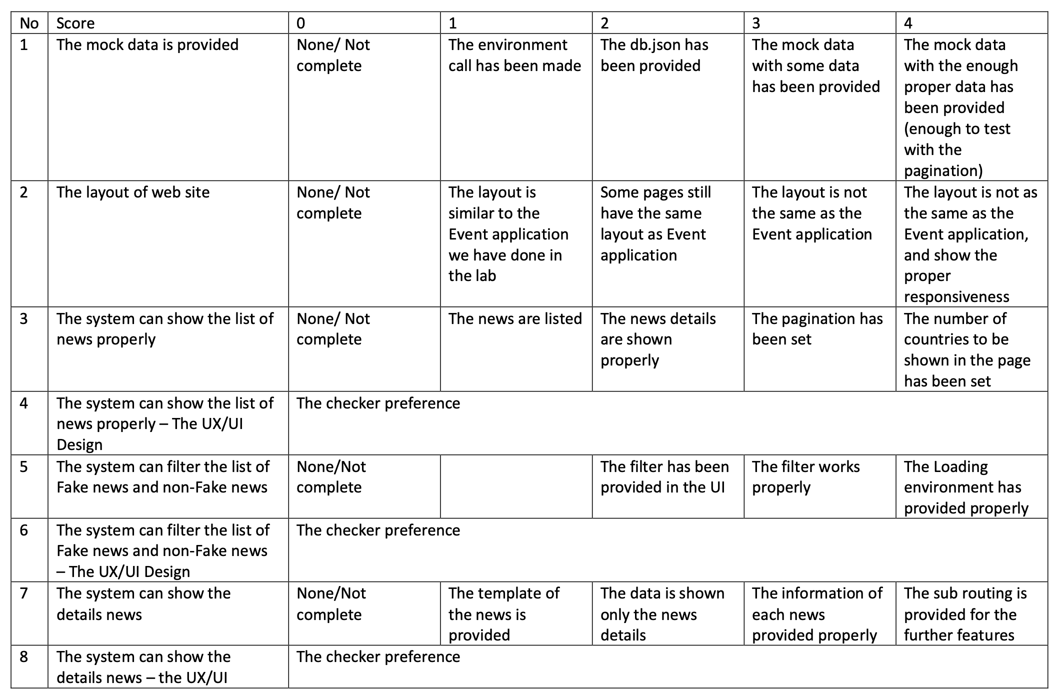

Slide 12
